Slide 1
Name: Swapnil Ghosh
Group: A2
Roll: 001911001067
TASK 13

Slide 2




Step-1) Opened the file GOODBYE.PSD in Photoshop and check boxed the bye layer.
Step-2) Choose Layer > Align Linked and explored the different option to generate this patterns of text.

Slide 3
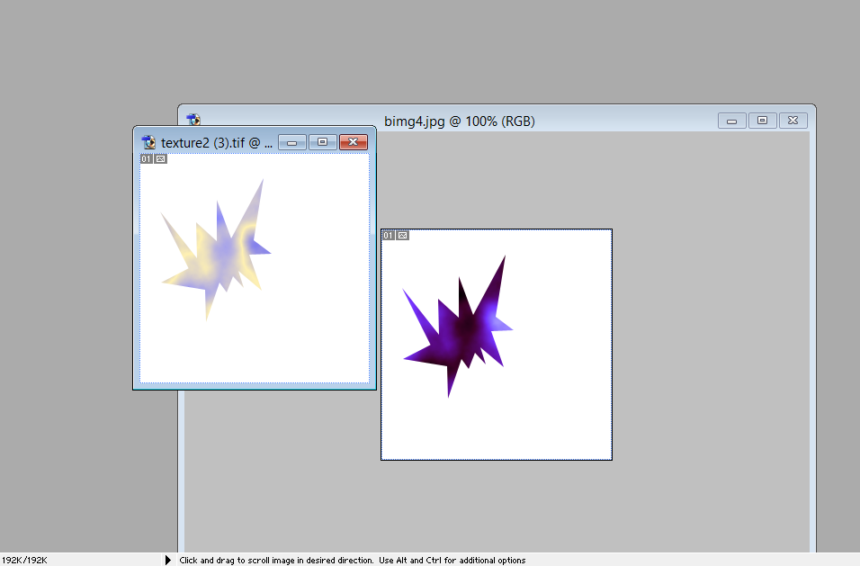
Step-1) Opened the file TEXTURE1.TIF in Photoshop.
Step-2) In Actions palette created a new Action Star and started the action.
Step-3) Used polygon lasso tool to create start shape and inverted the selection and deleted the remaining area.
Step-5) Opened the file TEXTURE2.TIF in Photoshop.
Step-6) Applied the saved action to this new Image.

